Slide 1
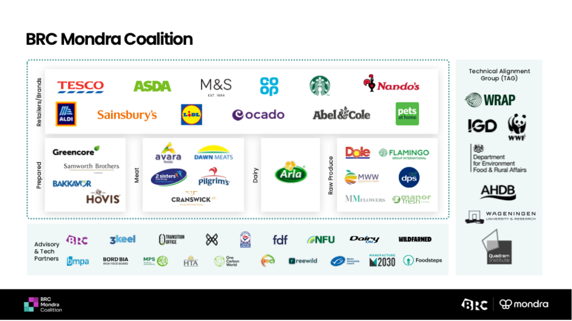

Slide 4



Mondra + ImpactBuying
More value from the data you already maintain.

Slide 5









Automatically generated PCFs from your pre-existing data in ImpactBuying.

Slide 6

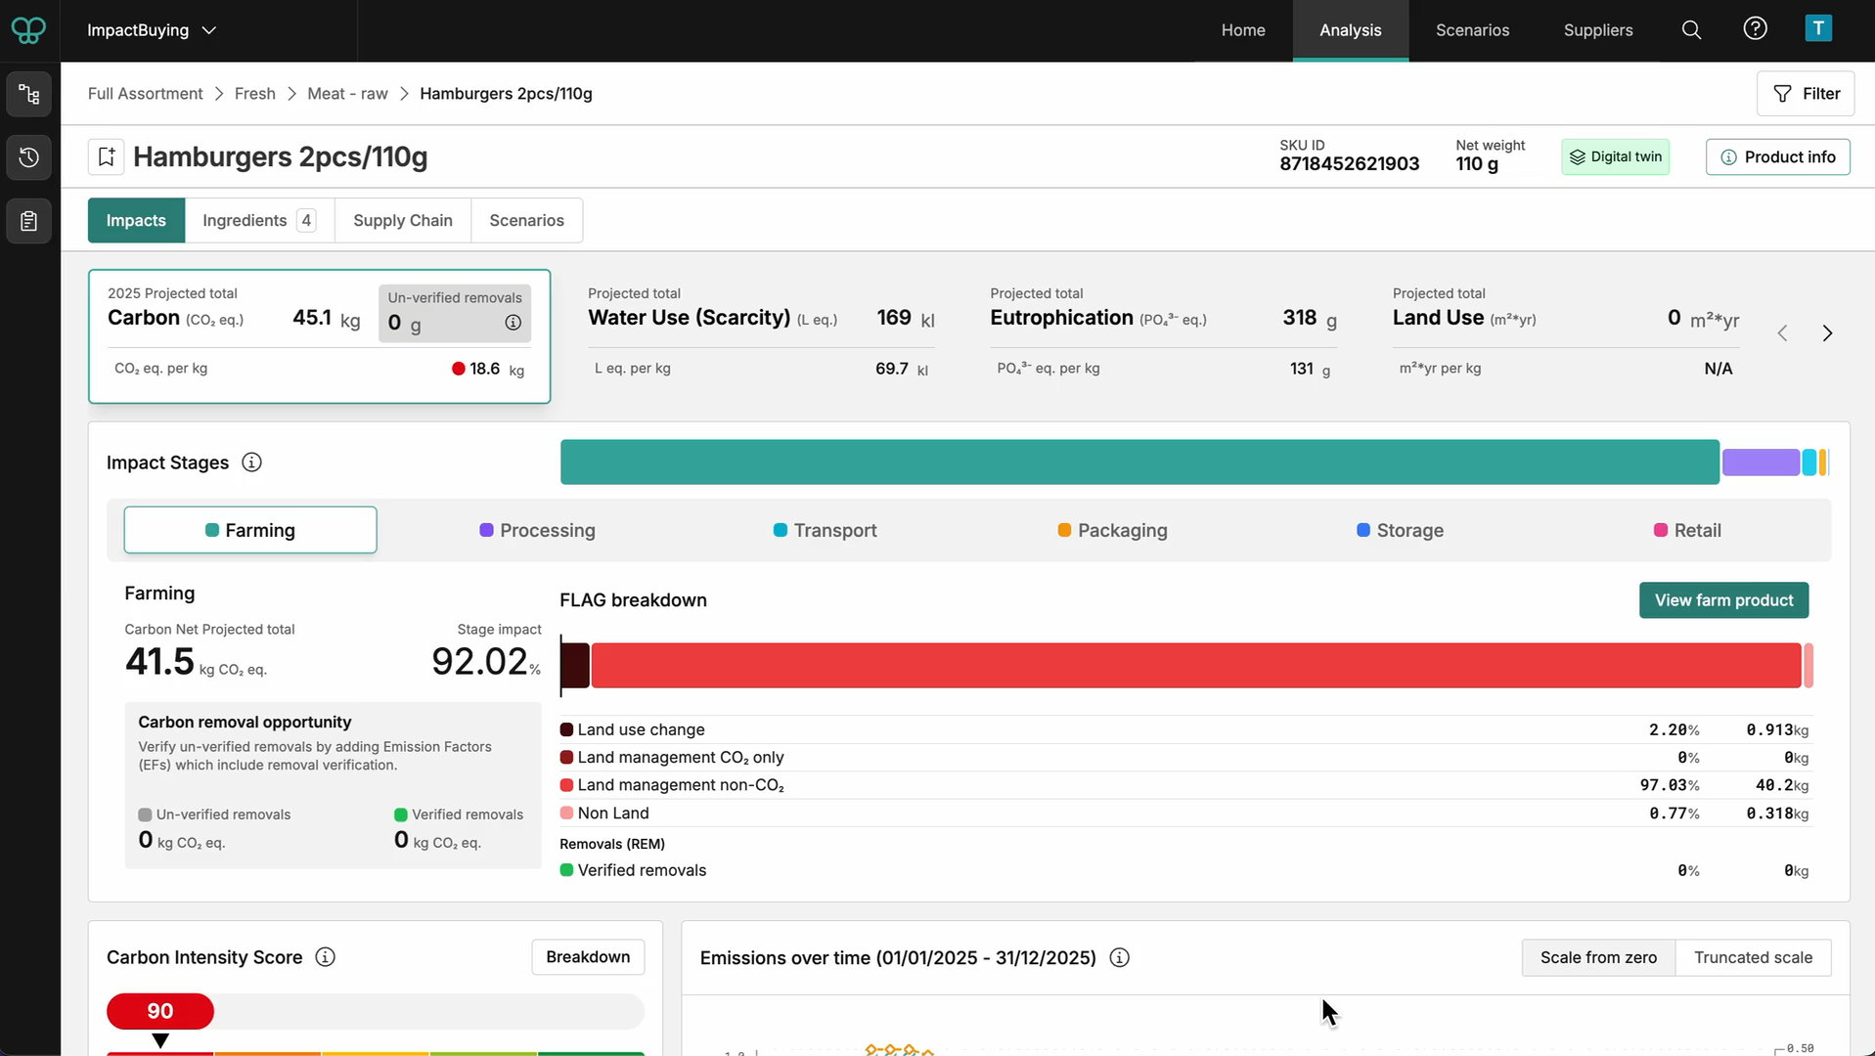


Slide 7








Download
methodology
Request your demo with Josh
josh@mondra.com

